Slide 1
Optimising Developing Heart Growth Problem
Hashem Yousefi

Slide 2
Outline
To do list ...
Issues which are not resolved
Action items from the other aspects
Plans for the following week
Submitting to the EMAC proceeding

Slide 3
To-do list
+ Checking if the model can be solved in smaller pieces
+ Create a coarser model as an alternative for the solving smaller pieces ()
+ Work with the B.Cs.
+ How to run in parallel or how to use NeSI
+ Exact growth rate in the literature
+ Optimisation Report is complete now? (not yet.)
+ On the paint mesh report: Add notation (for terms) + Still ambiguous (maybe Jagir can help more in writing some parts)

Slide 4
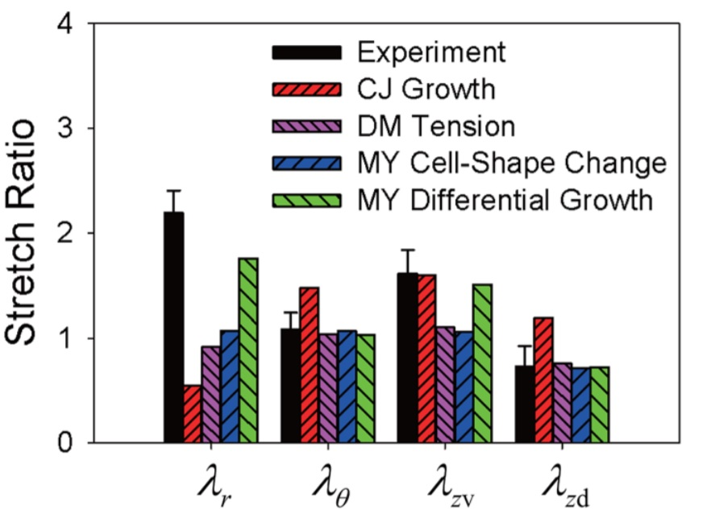
Growth Rate in the Literature
Different growth rates for different parts of the organ

Slide 5
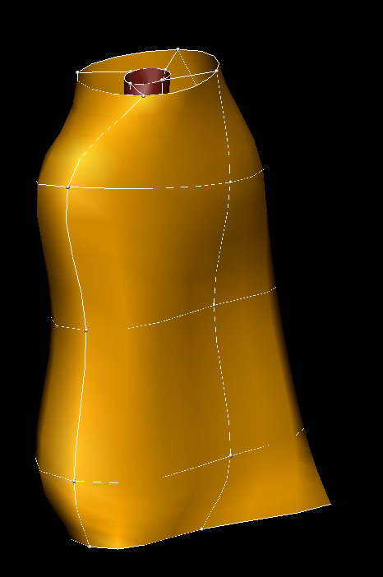
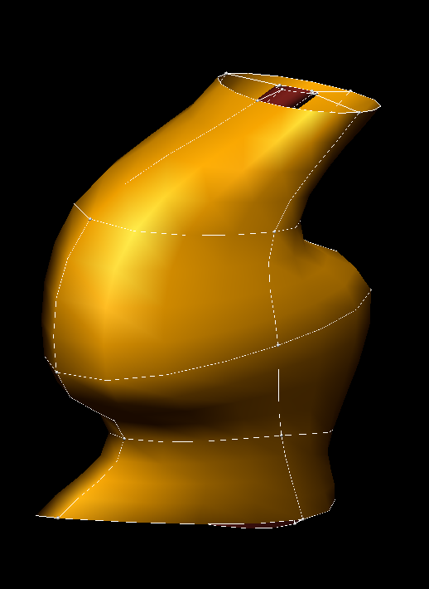
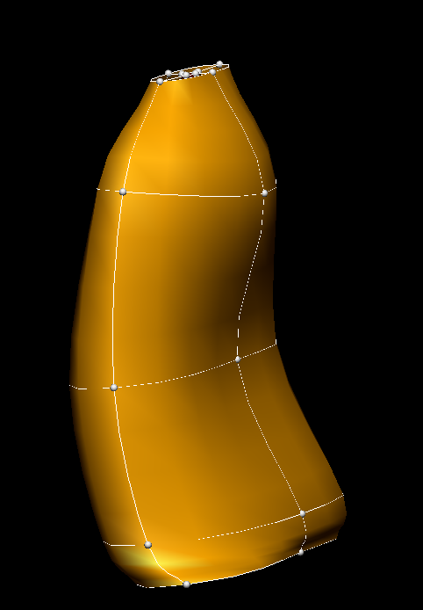
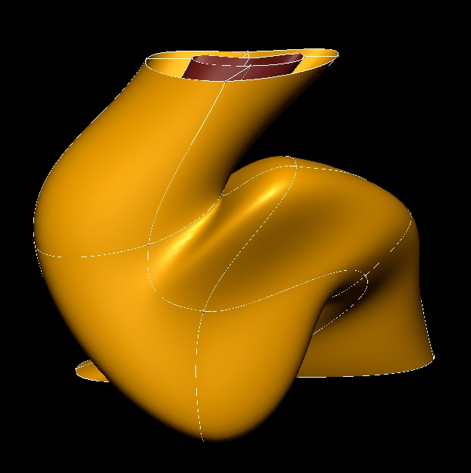
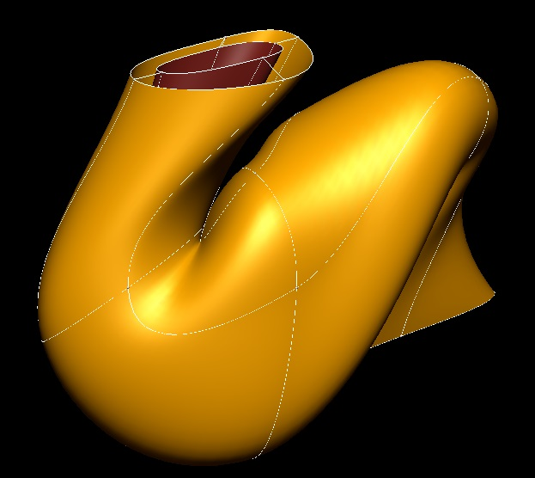
Coarser meshes

Slide 6
Problem for the Whole Model to Test 12 Growth Rates with ALHSO / ALPSO / SLSQP
Name | SLSQP | ALPSO | ALHSO
Problem | Stage 10 to 11 in 8*8 model With result of ALPSO | Stage 10 to 11 in 8*8 model Swarm size 5 Swarm size 5 | Stage 10 to 11 in 8*8 model Harmony size 30
Time | 6 hours | 53hours, 20hours | 23 hours,
Minimum Objective Value | No answer, first guess was not close maybe | 5.48e+6 (28 calls) 5.3e+6 (51 calls) | 5.48e+6 (26 calls) 5.42e+6 (49 calls)

Slide 7
Problem for the Course Model of 4x4 to Test 12 Growth Rates with 3 per each layer of elements with ALHSO / ALPSO / SLSQP
Name | SLSQP | ALPSO | ALHSO
Problem | Stage 10 to 11 in 8*8 model With result of ALPSO or ALHSO | Stage 10 to 11 in 4x4 Swarm size 10 | Stage 10 to 11 in 4x4 model Harmony size 30
Time | ------------------ | 5hours, 15hours | 6 hours, 24 hours or more …
Minimum Objective Value | Not have been tried yet … | Was stopoing sometimes 1.71e+6 (70 calls) 1.45e+6 (250 calls) | 2.17e+6 (57 calls) <1.9e+6 (500 calls)

Slide 8
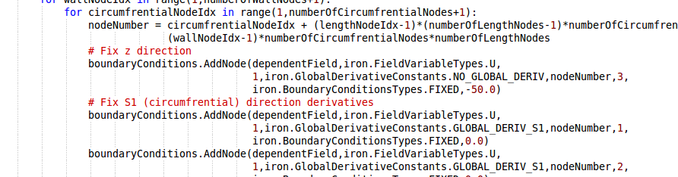
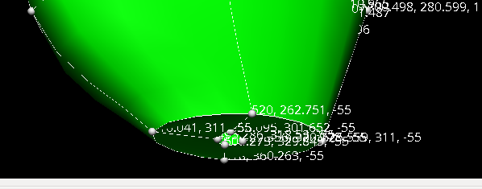
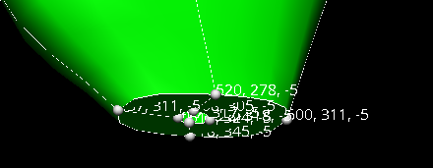
B.Cs. can be fixed as displacement? Changed

Slide 9
Unresolved issues
Bounds need to be more open as ALPSO came to the end of the bounds in most of the variables, however, we were facing errors.
More complex Boundary Conditions do not change the shapes?
The codes stops after a number on iterations.
How we need to decide about the origin? (relative registration and absolute registration), moving the B.Cs?
The shape of the model does not change much, it is better to have it top-side fixed?

